Slide 1
Human resources slide 1
HR Analyst
- Project

Slide 2
Human resources slide 2
Project Objective
On the basis of Human Resources dataset, an analysis has been performed to answer the following business requirements:
Is there any relationship between who a person works for and their performance score?
What is the overall diversity profile of the organization?
What are our best recruiting sources if we want to ensure a diverse organization?
Can we predict who is going to terminate and who isn't? What level of accuracy can we achieve on this?
Are there areas of the company where pay is not equitable?

Slide 3

Human resources slide 3
Dashboard covers the following
Diversity dashboard
Tableau
Tools & Technology Used
For data wrangling in order to make the dataset in format suitable for analysis
Attrition dashboards
Excel
To perform Diagnostic Analysis
Pay parity dashboards
In order to perform analysis and make interactive visual dashboards

Slide 4
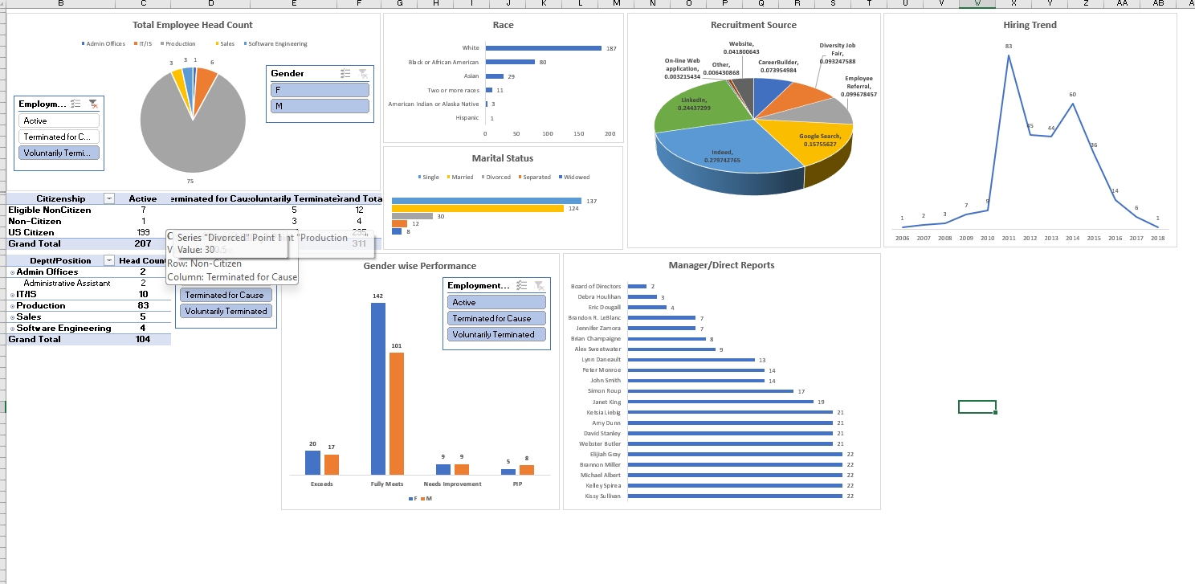
Human resources slide 7
Diversity Dashboard
The diversity dashboard provides a visual representation of the diversity profile in the organization
The diversity variables considered for total Head Count analysis are :
Gender
Citizenship
Race
Employment Status
Department wise HC
Manager span of control
Recruitment Source
Hiring trend
Gender wise employee performance
Note: Please refer to Excel file for the actual interactive dashboard

Slide 5
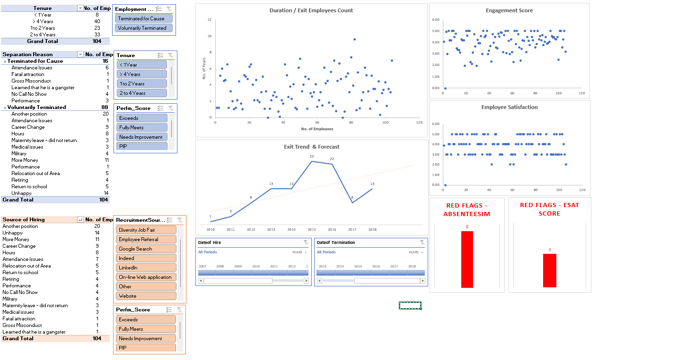
Human resources slide 7
Attrition Dashboard
The attrition dashboard provides a visual representation of the attrition analysis
Variables considered for attrition analysis are :
Tenure of employees resigning within 1yr, 1 -2 years, 2 – 4 years and < 4 Years to understand
Voluntary Separation vs Involuntary Separations
Exit Reasons with the source of recruitment
Duration and Exit employee count (Scatter Chart)
Employment Status
Exit trend and a linear forecast for the future
Identification of red flags (Potential Employees who may leave the organization) on the basis of Absenteeism and ESAT Score
Analysis of exiting employees in terms of their Engagement Score and ESAT Score
Note: Please refer to Excel file for the actual interactive dashboard

Slide 6
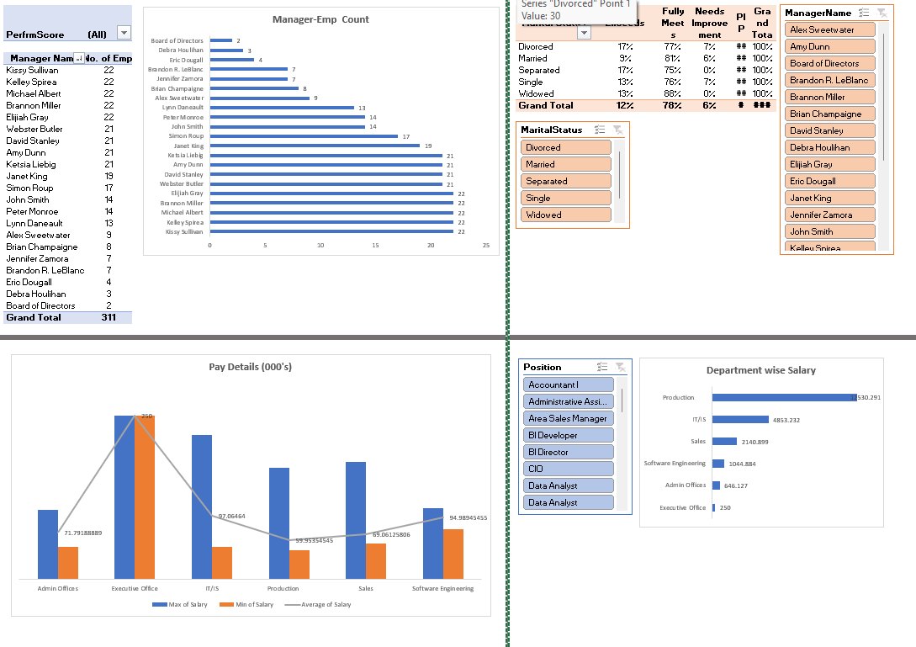
Human resources slide 7
Performance & Pay Parity Dashboard
This dashboard provides a visual representation of the analysis done to understand the following
How performance scores are influenced by managers span of control with a drill down analysis of performance of every employee respective to their reporting manager
Distribution of pay in various department and the average of departmental pay for comparison
Minimum and Maximum salary of every department
Distribution of total salary cost department wise
How the marital status and reporting manager influence the performance within the organization currently
Note: Please refer to Excel file for the actual interactive dashboard

Slide 7
Human resources slide 10
Thank You

Slide 8
Human resources slide 10
Appendix

Slide 9

Human resources slide 8
Steps followed
Data wrangling and cleaning done in Tableau to understand the data structure and get the data formatted in the unified manner (Especially date column for Date of Hiring and Date of Termination)
After performing the data cleaning explored the dataset to understand the key variables for creating various Measures and Calculated field in Ms. Excel
Created various Pivots and in order to facilitate interactivity and drill down used Slicers
Designed and Created a visual dashboard to get an insight about the data and conducted a diagnostic analysis of same

